Slide 1
Data Science Fundamentals
Logistic Regression

Slide 2
Before we get started…
Practicalities

Slide 3
Learning objectives
You understand and apply different types of regression, know when and how to use them, can execute them and put them in to practice as well as interpret the results.
You recognize overfitting in regression models and learn techniques to prevent overfitting.
You learn about different clustering techniques and understand when and how to use them for grouping data.
You gain an understanding of dimensionality reduction techniques and learn how to apply
them to compress and visualize data.

Slide 4

Course material
Canvas
  Slides & exercises from classes
Online
  https://www.w3schools.com/datascience/
Software
  JupyterLab (or work via Anaconda/VS Code if you prefer)
The Internet

Slide 5
Course breakdown
Course Structure:
  Lectures: 3 hours per week (theory and exercises)
  Attendance: Mostly not compulsory, but strongly recommended.
Examination Breakdown:
  30%: Continuous assessment (mandatory excercises)
  70%: Final exam (oral, mostly theoretical with some practical elements)

Slide 6

Is it difficult to pass?
It’s perfectly doable if you put in the work
Come to class
Participate in the lessons
Make your exercises

Slide 7
How to be an ideal student
Attend classes - even when you party hardy
Show respect - towards your instructor and fellow students
Be punctual - or you'll find the door closed
Meet deadlines - late submissions will earn a solid zero
Have a question? - just ask! I don't bite
Know it all? - help your classmates, they might repay you with pizza
Do your own work! - shortcuts will lead to a short academic career ;)

Slide 8
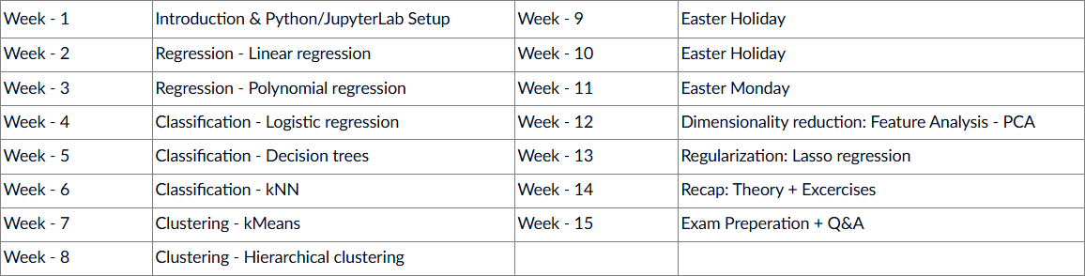



Agenda

Slide 9
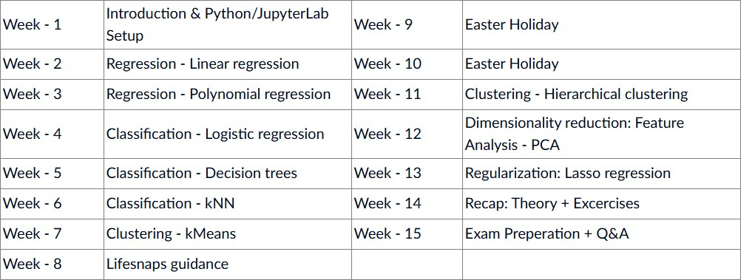
Syllabus
(subject to change)

Slide 10
Now we get to the fun part
Logistic Regression

Slide 11
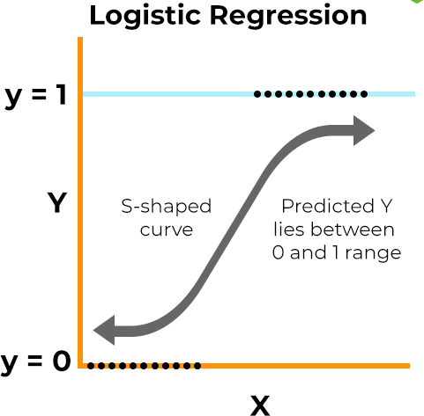
Regression, but not really
In its core a form of regression
S-shaped curve
Based on X, we predict Y
Y always lies between 0 and 1
  This interesting property allows
us to go beyond regression…
Notes:
Logistic regression is ALWAYS this S-shape!
It’s always a value between 0 and 1. Why would that be usefull?

Slide 12
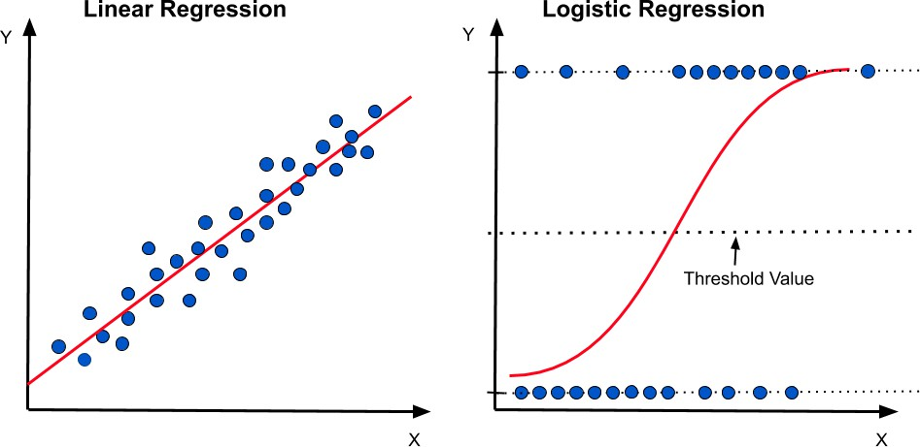
Regression as classification
By establishing a ‘threshold’ we can label each prediction as 0 or 1 → Classification!
Notes:
Because we can use this regression as a sort of classification model!
A certain threshold that determines whether a value is either A or B.
The main advantage thus being: classification model!

Slide 13

Binary classification
Always 0 or 1
Predicts if a certain factor is True or False
  E.g. Spam, Cancer, …
Simple yet limited
Notes:
This is binary classification: it’s either A or B, 0 or 1. Nothing in between, no 0,5 or 0,1 or anything: you are either A or B. You have cancer or not.

Slide 14

Multiclass classification
Can be anything
Predicts the type of a certain factor
  E.g. Wine quality rating, …
More complicated yet (almost) unlimited
Is classification supervised or unsupervised?
Supervised!
Notes:
This classification is supervised because you always know which of the possible labels will be an output.
MSE can not be applied to classification models: you either are right or wrong. MSE tries to measure how wrong you are, but that doesn’t make sense here: you either are wrong or you are right.

Slide 15
Evaluation metrics
True Positives (TP): The amount of labels where the outcome is 1 and the predicted label is 1. In other words, the amount of variables where we correctly predicted the postive outcome.
True Negatives (TN): The amount of labels where the outcome is 0 and the predicted label is 0. In other words, the amount of variables where we correctly predicted the negative outcome.
False Positives (FP): The amount of labels where the outcome is 0 and the predicted label is 1. In other words, the amount of variables where we incorrectly predicted the postive outcome.
False Negatives (FN): The amount of labels where the outcome is 1 and the predicted label is 0. In other words, the amount of variables where we incorrectly predicted the negative outcome.
Notes:
BEHOLD! THE CONFUSION MATRIX

Slide 16
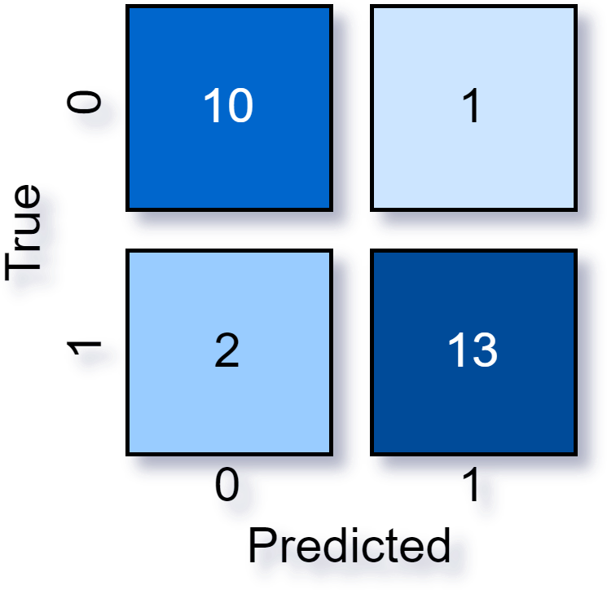
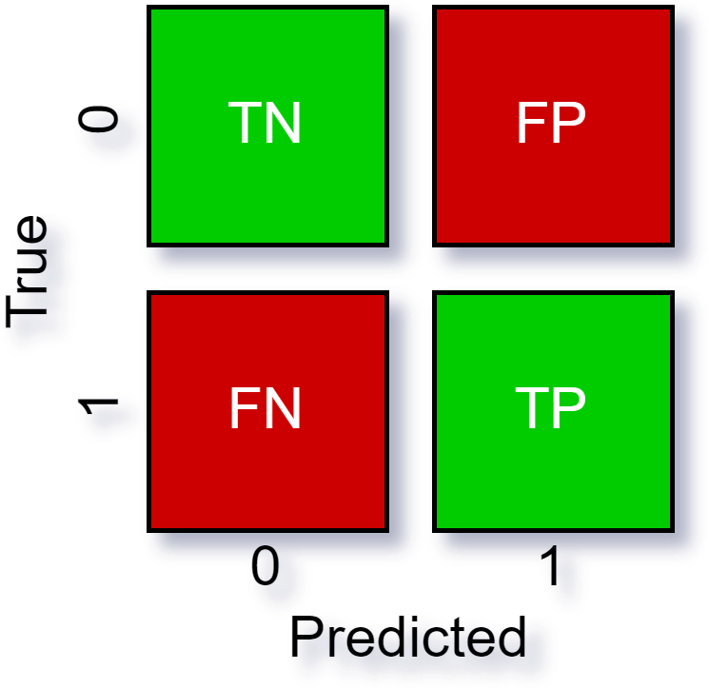
Confusion matrix matrix

Slide 17
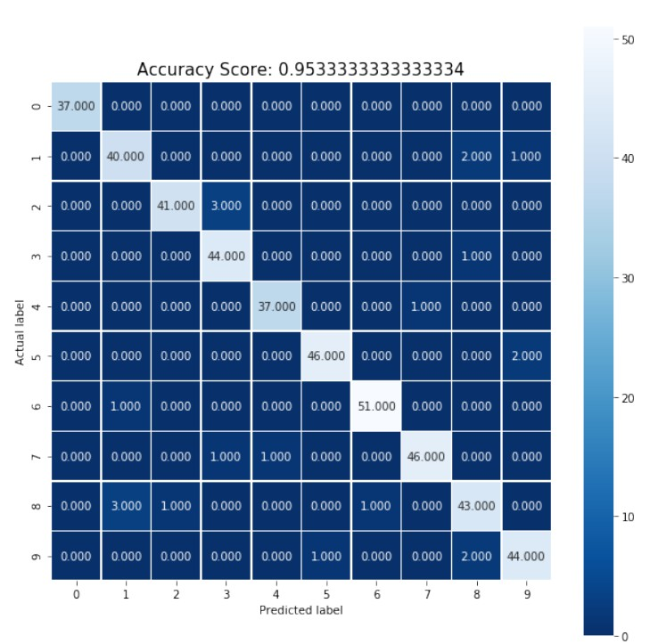
Confusion matrix matrix
The same goes for multiclass classification
Calculate TP/TN/FP/FN per class
You create an overal idea of your model by calculating an average
Python can do both for us :D
Now that we know the terminology, let’s
see what we can calculate with this…

Slide 18
Accuracy
Measures the proportion of correct predictions over all predictions.
Between 0 and 1
Higher is better
“How correct are my predictions?”
#𝑐𝑜𝑟𝑟𝑒𝑐𝑡 𝑝𝑟𝑒𝑑𝑖𝑐𝑡𝑖𝑜𝑛𝑠
𝐴𝑐𝑐𝑢𝑟𝑎𝑐𝑦 =
#𝑡𝑜𝑡𝑎𝑙 𝑝𝑟𝑒𝑑𝑖𝑐𝑡𝑖𝑜𝑛𝑠
𝑇𝑃 + 𝑇𝑁
^{𝐴𝑐𝑐𝑢𝑟𝑎𝑐𝑦 =} 𝑇𝑃 + 𝑇𝑁 + 𝐹𝑃 + 𝐹𝑁
Notes:
Same scale for R2:
Anything below 0,5 is no good.
0,5 is meh
Above 0,5 is usable to amazing
FORMULE MOET JE KENNEN

Slide 19
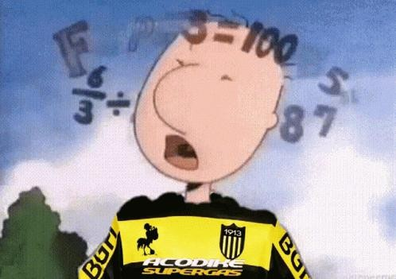
Precision
Measures how often the same prediction will be made, given more or less the same independent variables.
Higher is better
“How consistent are my predictions?”
𝑇𝑃
𝑃𝑟𝑒𝑐𝑖𝑠𝑖𝑜𝑛 =
𝑇𝑃 + 𝐹𝑃
Notes:
FORMULE MOET JE KENNEN

Slide 20

Accuracy vs precision
Let’s pauze for a moment to visualize the difference between accuracy and precision
Low accuracy
Low precision
Low accuracy
High precision
High accuracy Low precision
High accuracy High precision

Slide 21


Slide 22
Recall
Also called the True Positive Rate (TPR)
Proportion of actual positives correctly identified
Focuses on minimizing false negatives
  Important in medical diagnoses, …
“Of all positive values, how many did my model recognize?”
𝑇𝑃
𝑅𝑒𝑐𝑎𝑙𝑙 =
𝑇𝑃 + 𝐹𝑁
Notes:
FORMULE MOET JE KENNEN VOOR EXAMEN!

Slide 23
Specificity
Also called the True Negative Rate (TNR)
Proportion of actual negatives correctly identified
Focuses on minimizing false positives
  Important in fraud detection, …
“Of all negative values, how many did my model recognize?”
𝑇𝑁
𝑅𝑒𝑐𝑎𝑙𝑙 =
𝑇𝑁 + 𝐹𝑃
Notes:
Formule moet je kennen.

Slide 24

F1 Score
Harmonic mean of precision and recall
Gives a more balanced overview than accuracy
𝑃𝑟𝑒𝑐𝑖𝑠𝑖𝑜𝑛 ∗ 𝑅𝑒𝑐𝑎𝑙𝑙
𝐹1 𝑆𝑐𝑜𝑟𝑒 = 2
𝑃𝑟𝑒𝑐𝑖𝑠𝑖𝑜𝑛 + 𝑅𝑒𝑐𝑎𝑙𝑙
Notes:
Formule moet je kennennnn!

Slide 25

Further metrics
Is this all? Of course not!
There are many more metrics such as False Positive Rate (FPR), False Negative Rate (FNR), ROC, …
However, these fall out of the scope of Data Science Fundamentals.
You will be seeing them again in Data Science Advanced ;)

Slide 26
Let’s jump into action
Excercises

Slide 27

First, let’s explore this together
Go to canvas and download the notebook “DSF 04 – Logistic Regression Notebook”
Open the notebook in Jupyter
  Open a CMD and run “jupyter lab”
  Or launch it via anaconda
Follow along!

Slide 28

Now it’s up to you!
Go to canvas and download the notebook “DSF 04 - Logistic Regression Exercise”
Also download the csv file called “Diabetes.csv”
Place them in the same directory
Open the notebook in Jupyter
  Open a CMD and run “jupyter lab”
  Or launch it via anaconda
Go through the notebook and make the excercises
I don’t bite, ask me any questions you have!

